Slide 1
Introduction to Test Automation
WEB APPLICATIONS Hands-on Workshop
SHRUTI PANICKER QACC
23-10-24

Slide 2
Agenda
Overview
Introduction to test automation
Test automation & components
Demo – Hands on workshop
Final takeaways
Q&A
Wifi: Innovation Centre
Psw: Development2023
Notes:
Overview: Target Audience: Students with IT or programming background
Duration: 3.5h Here’s what we’ll cover today. We’ll start with an introduction to web test automation, followed by a hands-on session where we’ll work with a demo project using Selenium. Finally, we’ll wrap up with a recap and an open Q&A session.

Slide 3

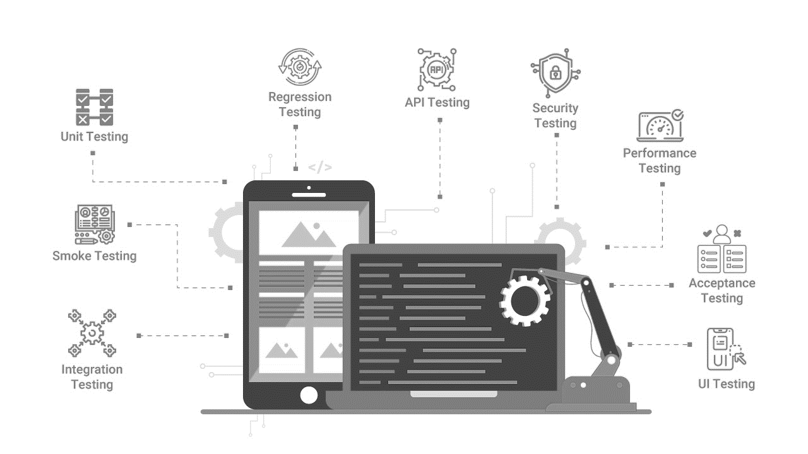
What is testing?
Manual Testing
Automated Testing
Notes:
Testing is a critical part of software development where one validates the behavior of an application as per the requirements. Manual testing involves humans executing test cases, which can be time-consuming and prone to errors. In contrast, automated testing uses scripts to perform these tests, offering speed and reliability.

Slide 4
Why AUTOMATe
SPEED UP THE RELEASE CYCLE
GIVES EARLY FEEDBACK
FLEXIBILITY AND SCALING
ENHANCED QUALITY
IMPROVES COMMUNICATION
STREAMLINED TEST CYCLES

Slide 5










Test Automation in AGILE
COMMIT
INITIATE CD PROCESS
Continuous integration
Continuous deployment
Continuous testing
CONTINOUS FEEDBACK
WITH AUTOMATED TESTS
MONITOR
TEST
Notes:
Continuous Integration (CI):
In Agile, developers frequently integrate code into a shared repository. Automated tests (especially unit tests) are run every time new code is integrated to ensure that new changes do not break existing functionality.
Continuous Delivery (CD):
Automated tests are essential in Agile to enable continuous delivery, where code is always in a deployable state. Automated test suites, such as integration and acceptance tests, validate that the software works in a production-like environment.
Continuous Testing:
Automated tests are continuously executed as code changes, ensuring that feedback is received quickly and bugs are identified early in the development process. This reduces manual testing time and allows developers to focus on fixing issues before moving forward.

Slide 6
Where Test Automation Fits
Unit Test: (large base) → Run often, fast, stable.
Integration tests: (middle layer) → Validate communication between parts.
UI/ End – End: (small top) → Test end-to-end functionality but run fewer due to complexity.
UI
Integration
Unit
TIME
COST/EFFORT
Notes:
1. Unit Tests
Purpose: Validate individual components or units of code in isolation, usually at the function or method level.
Focus: Ensures that each unit of the codebase works as expected independently from the rest of the system.
Automation Fit: Unit tests are highly automatable, quick to execute, and provide immediate feedback to developers. They form the base of the Testing Pyramid due to their frequency.
Example: Testing a function that calculates the sum of two numbers to ensure it always returns the correct result.
Benefits:
Fast execution
Detects issues early in the development cycle
Helps with refactoring by ensuring core functionality remains intact
2. Integration Tests
Purpose: Verify that different modules or components of the system work together as expected.
Focus: Ensures that the interaction between integrated parts (e.g., APIs, databases, services) is smooth and functions correctly.
Automation Fit: Automation is beneficial here because manual integration testing can be complex and error-prone. These tests are more complex than unit tests but still crucial.
Example: Testing the interaction between a web application and a database to ensure data retrieval and storage works as expected.
Benefits:
Identifies issues with communication between components
Verifies that dependencies work well together
Critical for applications with multiple layers or external integrations
3. Functional/Acceptance Tests
Purpose: Ensure the system meets the specified business requirements and works as intended for end-users.
Focus: Tests the functionality from the user's perspective to validate that the application behaves correctly in real-world scenarios.
Automation Fit: Automated functional tests (also known as acceptance tests) simulate user interactions with the application (e.g., logging in, filling forms). These tests are automatable but can be slower and more resource-intensive than unit or integration tests.
Example: Testing a user login workflow where a user enters valid credentials and is successfully authenticated and redirected to a dashboard.
Benefits:
Validates that business needs and use cases are met
Helps ensure end-to-end system functionality
Reduces manual testing for repetitive tasks
4. Regression Tests
Purpose: Ensure that previously developed and tested software still performs as expected after changes (like updates or new features).
Focus: Ensures that new code changes do not introduce bugs or break existing functionality.
Automation Fit: Automated regression tests are vital, especially in Agile environments where code changes happen frequently. A robust automated regression suite ensures stability after each release.
Example: Running tests to confirm that a feature that was previously working (like adding items to a shopping cart) is still functional after a new update.
Benefits:
Provides confidence that new changes do not introduce defects
Speeds up release cycles by reducing manual regression testing
Can be run repeatedly with minimal human intervention
5. Smoke Tests
Purpose: A subset of tests to quickly assess whether the most critical functions of an application are working.
Focus: Validates that the major functions of the software are operational before deeper testing begins.
Automation Fit: Smoke tests are typically automated and run after a new build or deployment to ensure the system is stable for further testing.
Example: After deploying a new build, verifying that the application launches, the login page loads, and basic navigation works.
Benefits:
Quick checks for build or release stability
Early detection of major issues before more in-depth testing
6. End-to-End (E2E) Tests
Purpose: Test the complete flow of an application from start to finish, simulating real-world user scenarios across multiple layers (UI, backend, database).
Focus: Ensures that the entire application is working together correctly across all systems, components, and interfaces.
Automation Fit: End-to-end tests can be automated but tend to be slower and more fragile because they touch many parts of the system. Automation tools like Selenium are often used for E2E testing.
Example: Testing the full checkout process in an e-commerce application, from product selection to payment and order confirmation.
Benefits:
Verifies complex workflows across multiple components
Catches issues that may be missed by unit or integration tests
Helps ensure the system behaves as expected for users
7. Performance/Load Tests
Purpose: Measure how the system performs under various conditions, such as high traffic or heavy load.
Focus: Tests the application's responsiveness, stability, and scalability under stress.
Automation Fit: Automation is ideal for performance testing because tools like JMeter or LoadRunner can simulate thousands of users interacting with the system simultaneously.
Example: Simulating 1,000 concurrent users accessing the application to assess how response times and resource usage change under load.
Benefits:
Ensures the system can handle expected user volumes
Identifies performance bottlenecks or limitations
Helps optimize infrastructure and scaling decisions
8. Security Tests
Purpose: Identify vulnerabilities and security flaws in the application.
Focus: Ensures that the application is secure from threats like SQL injections, cross-site scripting (XSS), and other malicious attacks.
Automation Fit: Automated security testing tools (e.g., OWASP ZAP, Burp Suite) can continuously scan the application for known vulnerabilities and security risks.
Example: Running an automated scan to detect SQL injection vulnerabilities in a login form.
Benefits:
Helps protect the application and users from potential attacks
Automates the identification of common vulnerabilities
Critical for applications dealing with sensitive data or financial transactions

Slide 7





Tools for Web Automation
Selenium: Most widely used, supports multiple browsers debugging
Playwright: Supports multiple languages and browsers, offers robust
Cypress: Modern tool with real-time reloads and features
Notes:
There are several tools available for web automation. Selenium remains the most popular due to its versatility and extensive community support. Other tools like Cypress, Playwright, and Puppeteer offer modern features and are gaining traction. Additionally, platforms like BrowserStack and SauceLabs provide mobile testing for cross-browser compatibility.

Slide 8
JAVA -Concepts
Conditions(if, if-else, switch)
Loops(for, while, do-while, for-each)
Oops(Inheritance, Polymorphism, Encapsulation, Abstraction)
Method overloading, overriding
Constructors
String
Type casting
Code optimization
Collection(List and Set)

Slide 9
Selenium
Selenium WebDriver: Interacts directly with the browser, mimicking real user actions.
Selenium IDE: A record-and-playback tool for creating tests.
Selenium Grid: Allows running tests on multiple machines and browsers in parallel.
Notes:
It allows users to simulate and automate browser interactions like clicking buttons, filling forms, or navigating web pages. Selenium is widely used for testing web applications because it can simulate user behavior in a real browser. What is an interface? It defines a set of abstract methods (methods without a body), and any class that implements an interface must provide implementations for all the methods declared in the interface. Interfaces help in achieving abstraction and multiple inheritance in Java.

Slide 10
Selenium Webdriver
WebDriver is an interface in the Selenium library that defines methods for automating browser-specific actions.
get(String url): Opens a specific webpage.
findElement(By by): Finds a web element on the page.
click(): Clicks on an element (e.g., a button or a link).
sendKeys(CharSequence keys): Enters text into an input field.

Slide 11
Selenium Webdriver Methods
get()
getTitle()
getCurrentUrl()
getPageSource()
findElement()
getWindowHandle()
manage()
close()
quit()

Slide 12
LOCATORS
Locator Type | Syntax (Java) | Description | Example
By ID | By.id("elementID") | Finds element by its `id` attribute (unique identifier). | WebElement element = driver.findElement(By.id("username"));
By Name | By.name("elementName") | Finds element by its `name` attribute. | WebElement element = driver.findElement(By.name("email"));
By Class Name | By.className("elementClassName") | Finds element by its `class` attribute. | WebElement element = driver.findElement(By.className("form-control"));
By Tag Name | By.tagName("tagName") | Finds element by its HTML tag (e.g., `input`, `button`, etc.). | WebElement element = driver.findElement(By.tagName("input"));
By Link Text | By.linkText("Exact Link Text") | Finds a hyperlink (`<a>`) by its exact link text. | WebElement element = driver.findElement(By.linkText("Home"));
By Partial Link Text | By.partialLinkText("Partial Link Text") | Finds a hyperlink (`<a>`) by a portion of the link text. | WebElement element = driver.findElement(By.partialLinkText("Log"));
By CSS Selector | By.cssSelector("cssSelectorExpression") | Finds elements using a CSS selector (very flexible for targeting attributes). | WebElement element = driver.findElement(By.cssSelector("input[type='password']"));
By XPath (Absolute) | By.xpath("/html/body/div[1]/input") | Finds element using an absolute XPath (starting from root). | WebElement element = driver.findElement(By.xpath("/html/body/div[1]/input"));
By XPath (Relative) | By.xpath("//tag[@attribute='value']") | Finds element using a relative XPath (based on attributes or relationships). | WebElement element = driver.findElement(By.xpath("//input[@id='password']"));
Notes:
// Using ID
WebElement usernameField = driver.findElement(By.id("username"));
usernameField.sendKeys("myUsername");
// Using CSS Selector
WebElement passwordField = driver.findElement(By.cssSelector("input[type='password']"));
passwordField.sendKeys("myPassword");
// Using XPath
WebElement loginButton = driver.findElement(By.xpath("//button[@type='submit']"));
loginButton.click();

Slide 13
Test Execution Runner
Responsible for executing test cases or test suites in a test automation framework.
It acts as the entry point for running automated tests and ensures that all test cases are executed according to predefined configurations.

Slide 14
Test Execution Runner - FEATURES
Annotations:
@Test: Marks a method as a test case.
@BeforeEach and @AfterEach: Run before and after each test, respectively.
@BeforeAll and @AfterAll: Run once before and after all test cases in a class.
@Ignore: Skips the execution of a test case.
Assertions:
assertEquals(expected, actual): Asserts that two values are equal.
assertTrue(condition): Asserts that a condition is true.
assertNull(object): Asserts that an object is null.
Notes:
Test Runner:
The JUnit Test Runner is responsible for running the tests and collecting the results (pass, fail, or skip).

Slide 15
Framework
Design pattern (POM)
Test data config (Properties file for envs)
Helper/Utility classes
Test execution runner (Selenium-Junit)
Logging (Debugging and transparency)
Allure report Integration (Reporting integrations)

Slide 16
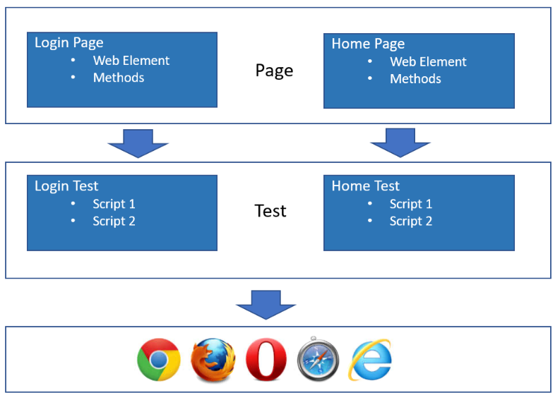
Page object model
Enhances test maintenance and reducing code duplication

Slide 17
Bonus – Jenkins
An open-source automation server that helps automate parts of software development related to building, testing, and deploying code.
It is widely used for continuous integration (CI) and continuous delivery (CD) pipelines, making it a key tool in modern DevOps practices.
In test automation by automating the process of running test suites after code changes, helping developers get quick feedback on their code's quality.

Slide 18
PRE-requisites
JAVA JDK setup
Maven setup
IntelliJ
Github Account

Slide 19
DEMO
Github:
https://github.com/shrubom/kood-johvi-workshop.git

Slide 20
resources
Selenium: https://www.selenium.dev/documentation/webdriver/
Locators: https://www.selenium.dev/documentation/webdriver/elements/locators/
Junit: https://junit.org/junit5/docs/current/user-guide/
Allure: https://allurereport.org/docs/how-it-works/
POM: https://www.selenium.dev/documentation/test_practices/encouraged/page_object_models/
Jenkins: https://www.jenkins.io/doc/tutorials/

Slide 21
FINAL TIPS & TAKEAWAYS
Speeds up testing: Automation accelerates test execution, saving time
Ensures reliability: Automated tests provide consistent and accurate results
Boosts coverage: It allows more tests to be run, improving overall quality.

Slide 22
THANK YOU
Shruti Panicker
Senior Test Automation Engineer
QACC, SEB Estonia

